Slide 1


AI and art
William Trimble
Spring 2022

Slide 2
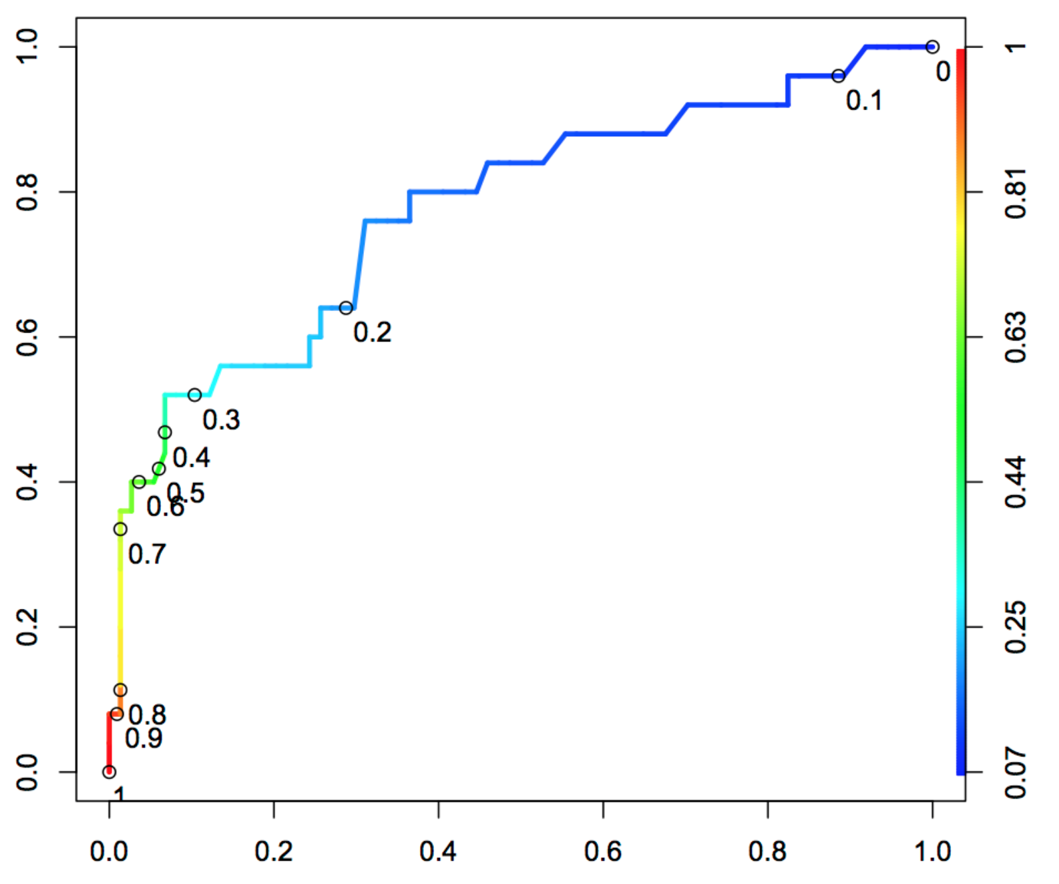
TPR
https://stats.stackexchange.com/questions/470696/threshold-coded-roc-curve-interpretaion
FPR = 1-TNR

Slide 3
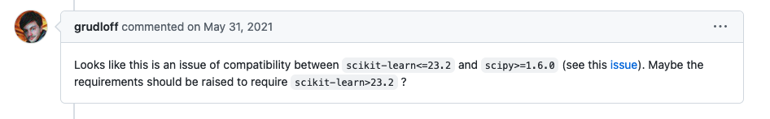
Dependency hell…
While preparing notes for Wednesday, I encountered a Unicode decode error from scikitlearn’s LogisticRegressionCV method.
Since the data was numpy arrays (no Unicode!) I took this to be a bug.
https://github.com/scikit-optimize/scikit-optimize/issues/981
Bug fix in scipy broke scikit-learn
Can anything be done?

Slide 4
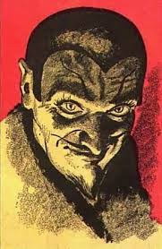
Pinned versions: A deal with the devil
When your code needs stability, you can insist on the version and subversion number of the operating system, the python engine, and the scientific libraries.
API of scientific libraries slowly evolves. “DeprecationWarning” anyone?
Expect code that specifies pinned versions to work 100% until it breaks, and then it will break catastrophically.
Pinned version code is more needy than shotgun code; it needs more hard drive space, separate computing environments, containers…

Slide 5
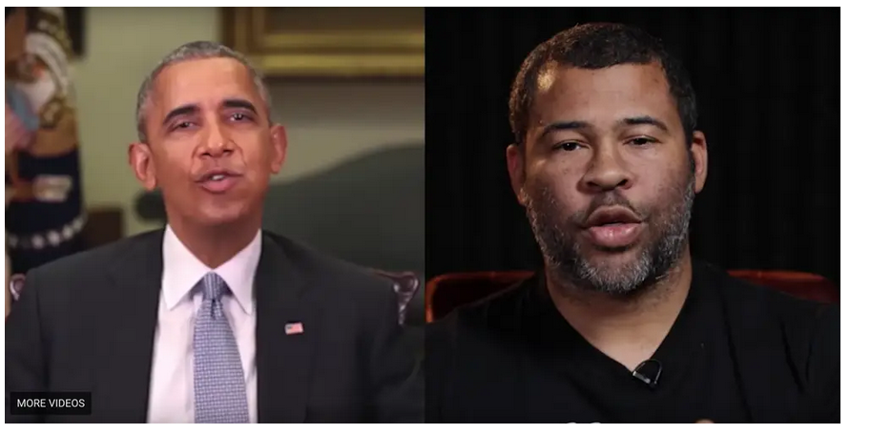
A viral video that appeared to show Obama calling Trump a 'dips---' shows a disturbing new trend called 'deepfakes’ Kaylee Fagan Apr 17, 2018, 3:48 PM
https://www.businessinsider.com/obama-deepfake-video-insulting-trump-2018-4

Slide 6
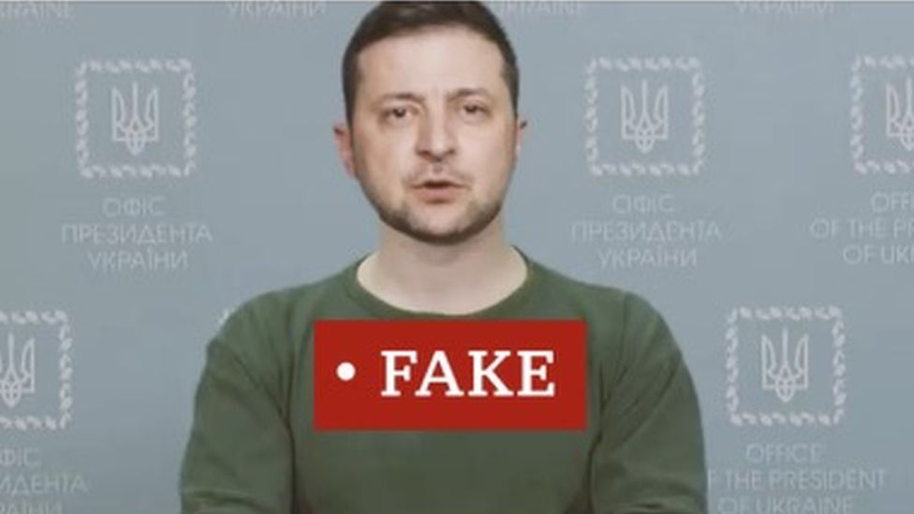
Caught in the wild (without Cassandra disclaimer)
https://www.wired.com/story/zelensky-deepfake-facebook-twitter-playbook/
Mar 17, 2022 Tom Simonite A Zelensky Deepfake Was Quickly Defeated. The Next One Might Not Be

Slide 7
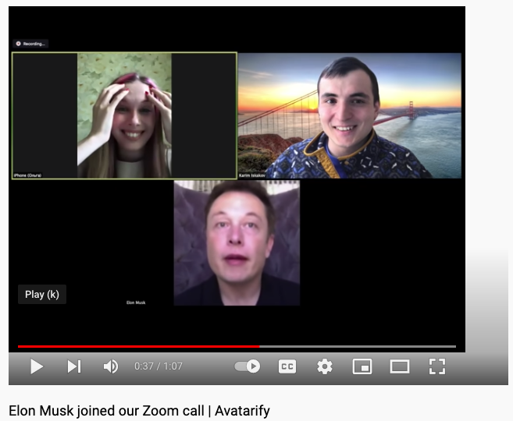
https://www.youtube.com/watch?v=lONuXGNqLO0

Slide 8
Avatarify – server for streaming video faceswap
https://github.com/alievk/avatarify-python

Slide 9
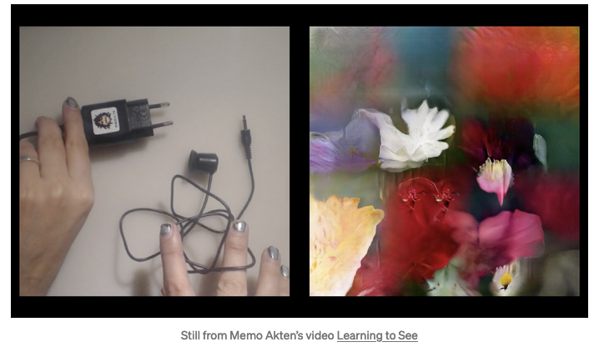
Learning to see, gloomy Sunday morning

Slide 10
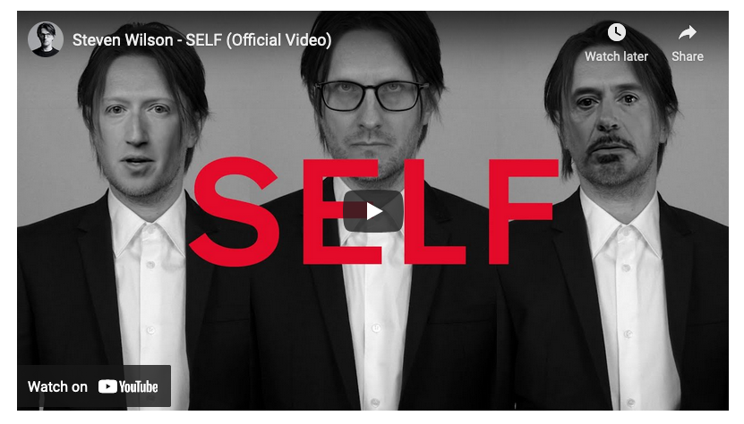
https://youtu.be/UroVey4fJ_g

Slide 11
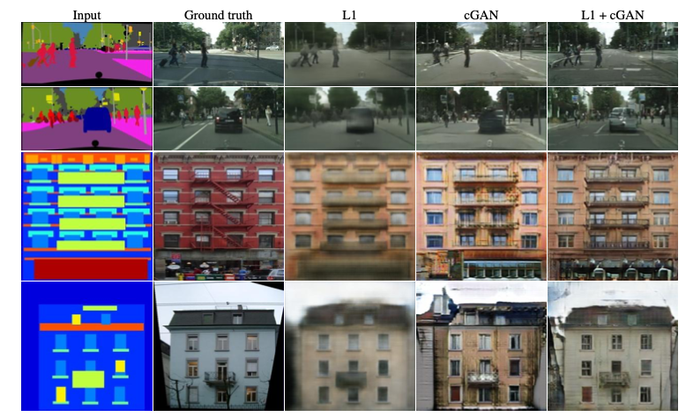
pix2pix -- CNNs trained on image pairs

Slide 12
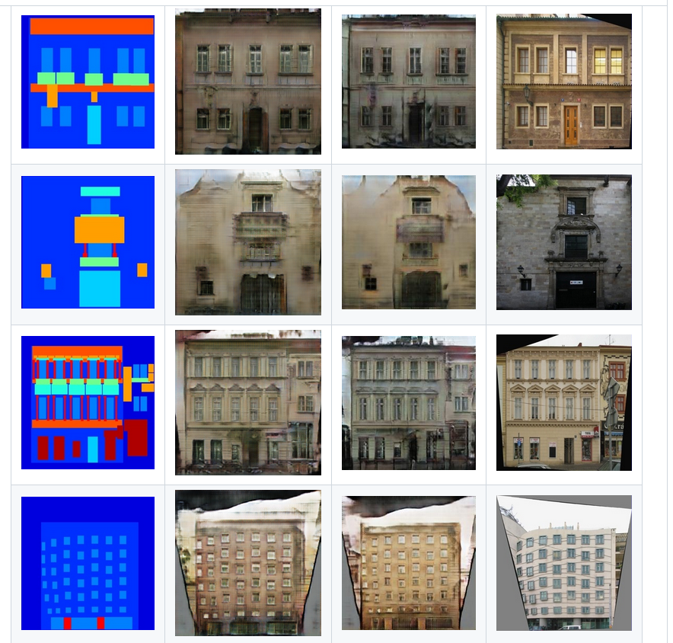
pix2pix -- CNNs trained on image pairs

Slide 13
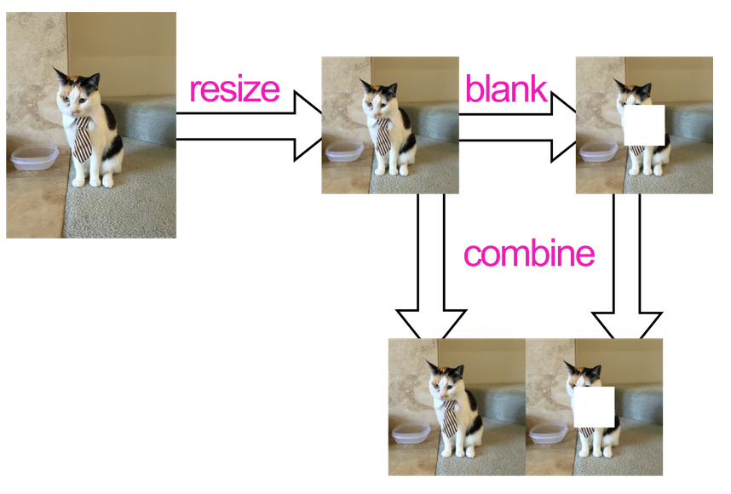
https://github.com/affinelayer/pix2pix-tensorflow

Slide 14
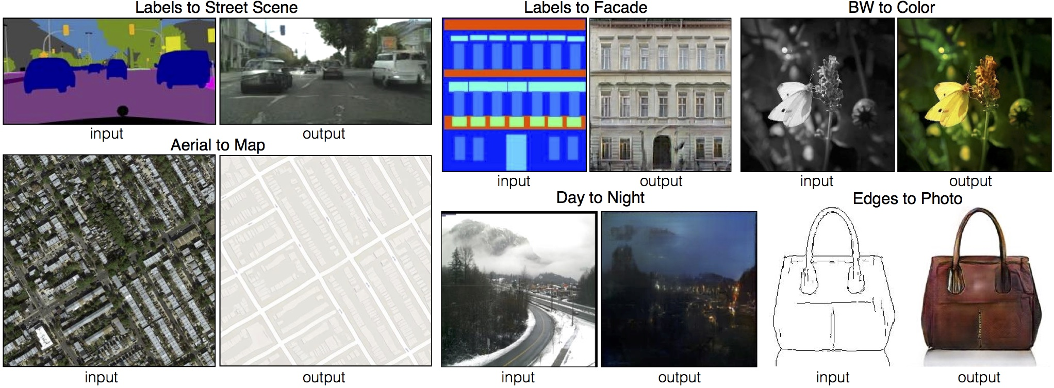
pix2pix -- CNNs trained on image pairs
https://github.com/affinelayer/pix2pix-tensorflow

Slide 15
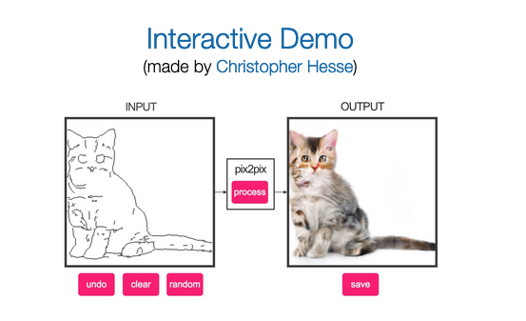
Edges2cats
https://phillipi.github.io/pix2pix/
https://affinelayer.com/pixsrv/

Slide 16
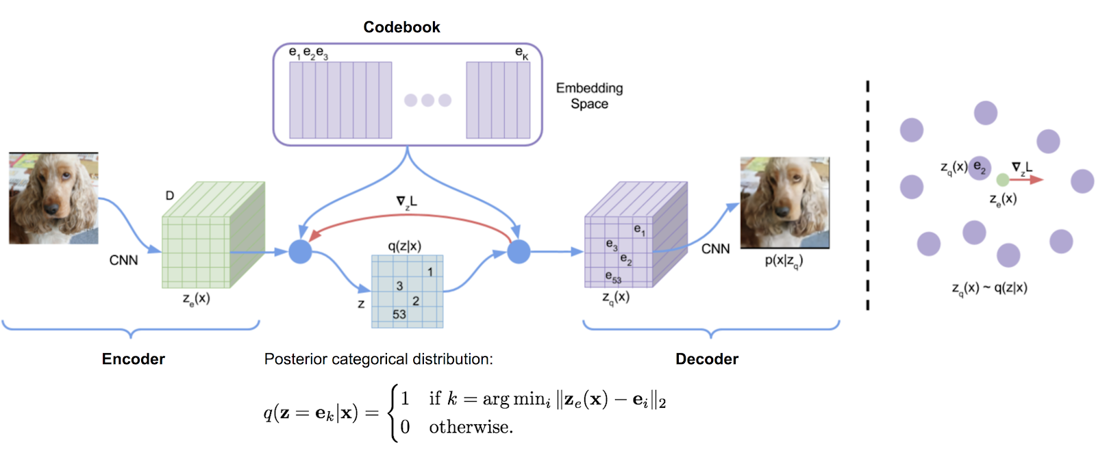
OpenAI: DALL-E: trained to generate images from text

Slide 17
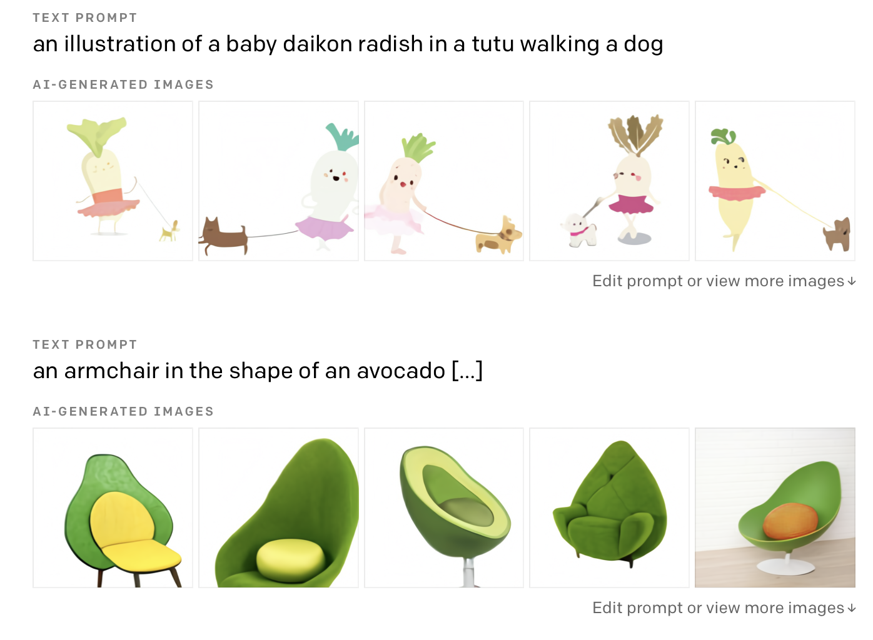

Slide 18
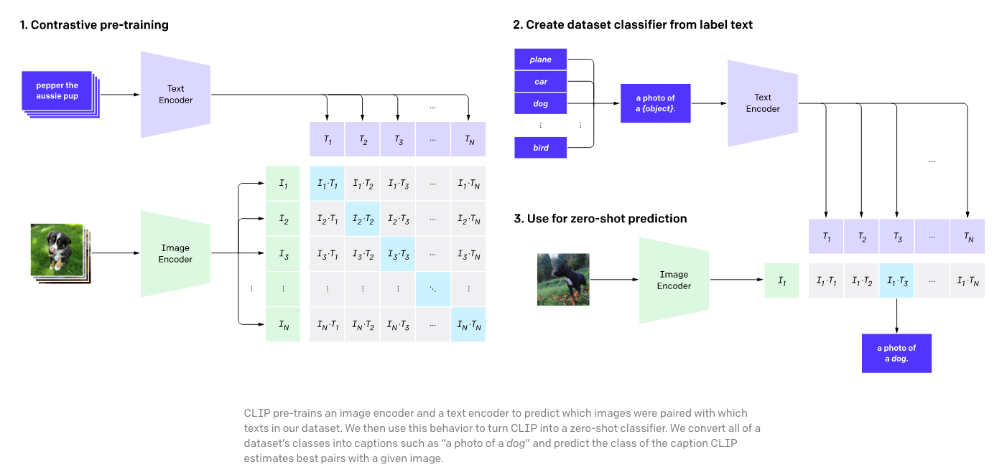
CLIP: another text-to-image framework
openAI CLIP (Jan 2021) : https://openai.com/blog/clip/

Slide 19
ART MACHINE: Put in text, get AI art.
https://is.gd/artmachine -> https://colab.research.google.com/drive/1n_xrgKDlGQcCF6O-eL3NOd_x4NSqAUjK

Slide 20
Applications abound
Colorization
Image upscaling

Slide 21
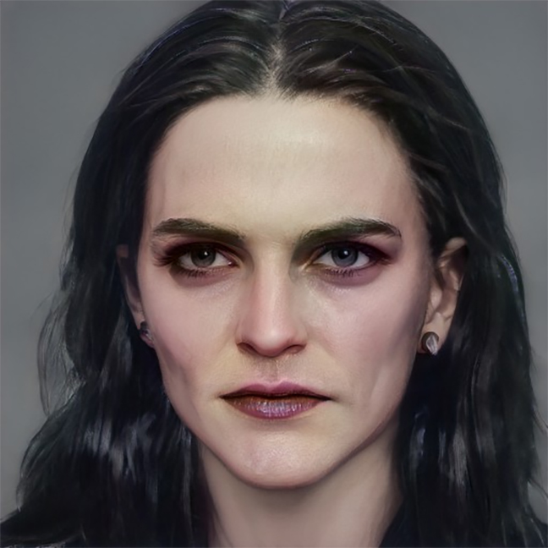
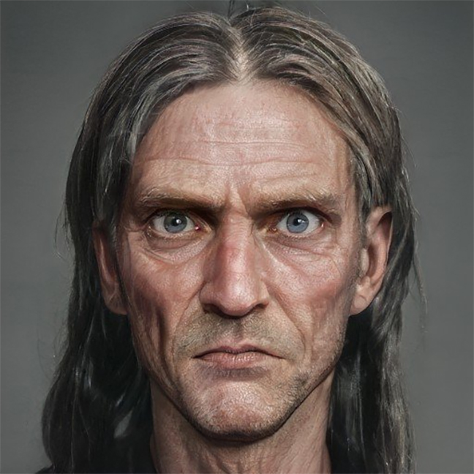
Bellatrix: (mid 40s) long shiny thick black hair, strong jaw, dark hooded eyes, thin lips, gaunt from long term imprisonment, still has vestiges of old beauty
Argus Filch: (?age?) bulging eyes, pale eyes, sunken cheeks, pasty-faced, (missing bald patch)
https://imgur.com/gallery/bwsDnLm

Slide 22
Why is this happening?
The math is decades old, but the cool applications are in the past 10 years.
The math will endure, matplotlib, ggplot, torch, tensorflow may fall out of style
Cheaper compute, cheaper storage, cheaper network, more data
Lower barrier to entry (notebooks, collab) means many more people working with ML/AI tools
Look at the amount of art! AI isn’t just for giant corporate conglomorates anymore.

Slide 23
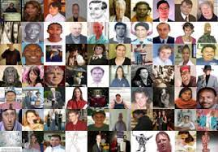
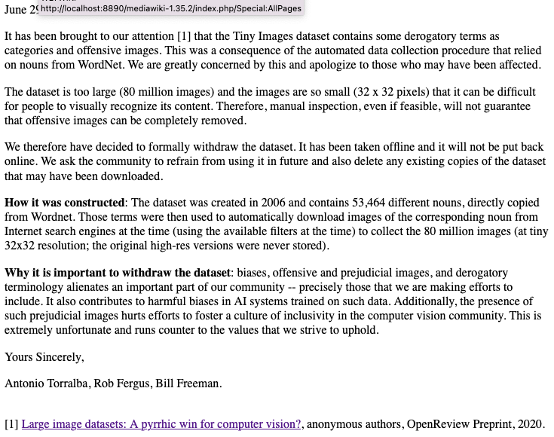
With great power comes great responsibility
https://groups.csail.mit.edu/vision/TinyImages/

Slide 24
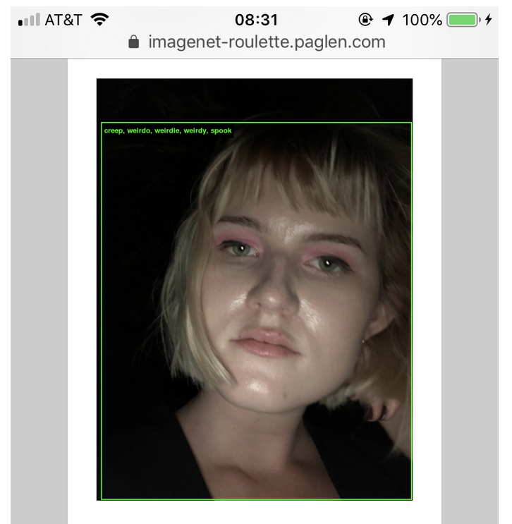
Imagenet roulette (art project)
https://excavating.ai/
ImageNet contains 2,833 subcategories under the top-level category “Person.”
As we go further into the depths of ImageNet’s Person categories, the classifications of humans within it take a sharp and dark turn. There are categories for Bad Person, Call Girl, Drug Addict, Closet Queen, Convict, Crazy, Failure, Flop, Fucker, Hypocrite, Jezebel, Kleptomaniac, Loser, Melancholic, Nonperson, Pervert, Prima Donna, Schizophrenic, Second-Rater, Spinster, Streetwalker, Stud, Tosser, Unskilled Person, Wanton, Waverer, and Wimp. There are many racist slurs and misogynistic terms.
Image of journalist Izzy Stephen tagged with a subset of Imagenet’s unflattering person labels.
https://medium.com/@isobel.stephen/what-can-we-learn-from-ai-art-4b0a52476dd9

Slide 25
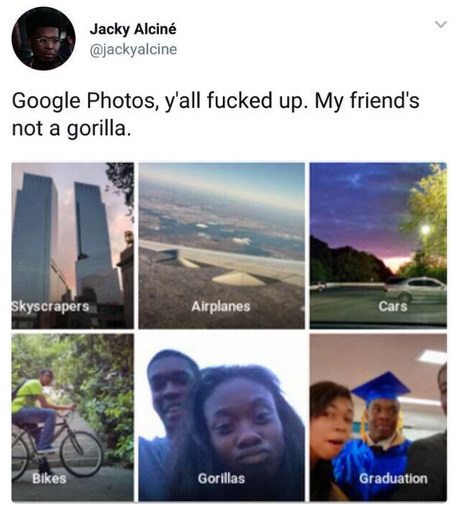

Slide 26
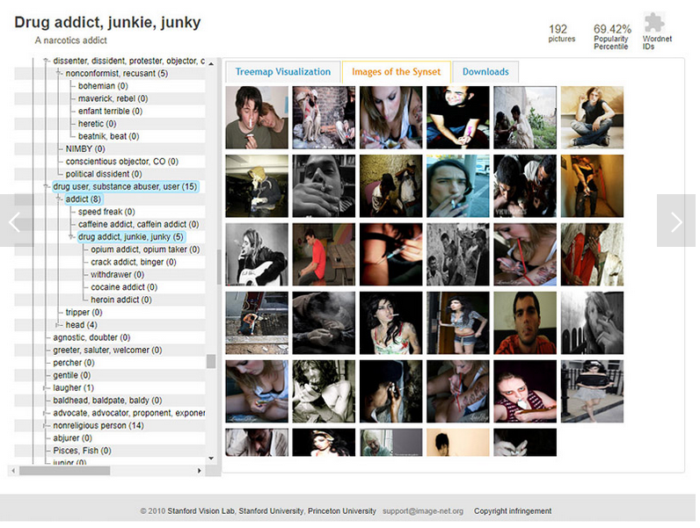
Image databases need careful review..
http://www.wired.com/story/viral-app-labels-you-isnt-what-you-think

Slide 27
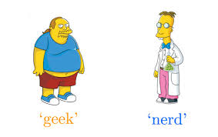
How much is technical?
What is the difference between a geek and a dork?
Programmers in corporate environments don’t struggle with syntax, documentation, troubleshooting. They struggle with managing relationships.
When do you ask for help? Who do you ask? (Type I errors and Type II errors both cut into productivity)
In academic environments, specialization of knowledge (stovepiping) means elite researchers just collaborate to get the expertise they need.

Slide 28
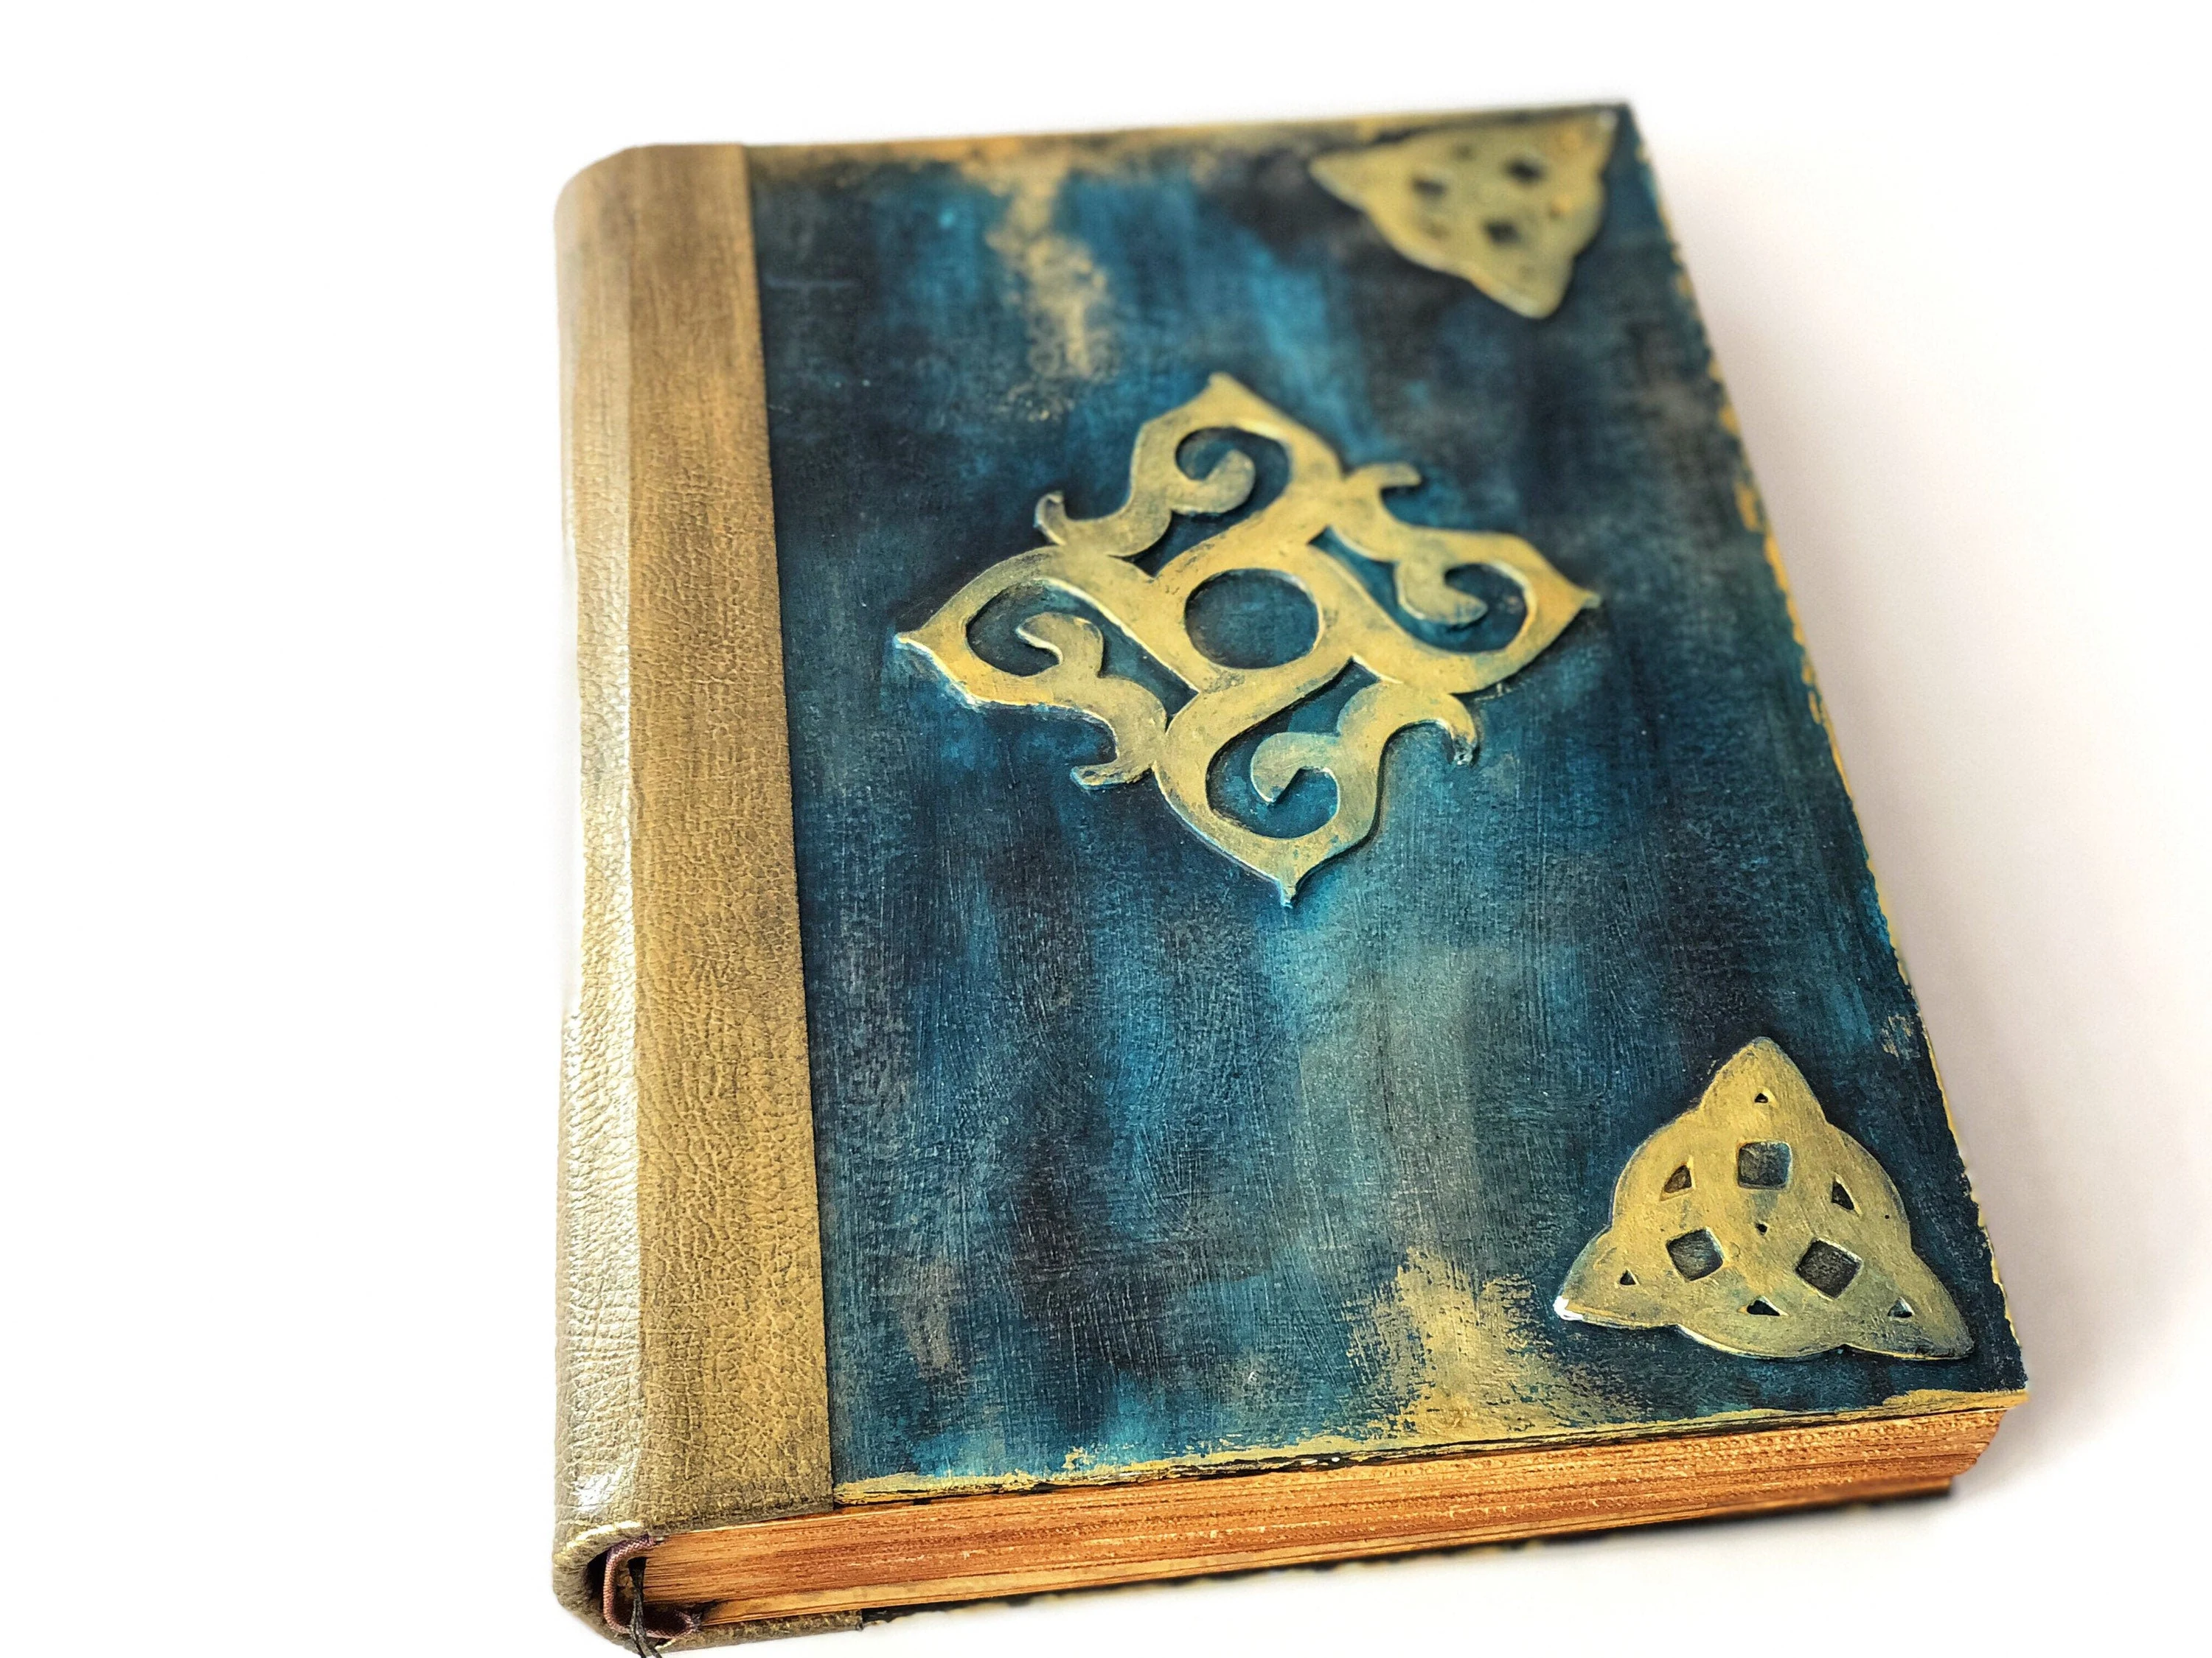
Try to use the spells in the spellbook for good?

Slide 29
Next year?
Less hard math week 1 & 2.
More straightforward (aready-solved, not impossible) assignments. Post answers to assignments with problem specification.
Prereqs: multivariable calculus, intro CS. (linear algebra and probability theory were missing from prereqs)
++ Tree-based models, gradient boosting, feature selection

